Slide 1
Prediction of Incident Clearance Time for I-495

Slide 2
STEP 1 : Adjusted interval-based models classification rules
STEP 2 : Recalibrated interval-based models interval boundaries modified
STEP 3 : Adjusted CF rules for I-495
STEP 4 : Developed supplemental rules
STEP 5: Evaluated the upgraded Interval-based Model
I495(2015-2017)
I495(2018)

Slide 3
Adjusted interval-based models classification rules modified

Slide 4
Travel lane blockage – CPI - 1 Travel lane blockage
CLASSIFICATION RULES
 | Description |  | Case | CT range (minutes) | Mean CT (mins) | I-495 (2015-2017)
IF | [TOW service arrived] | THEN | CPI-1Lane-2 | ≥ 30 | 70 | 69%(56/81)
IF | [FIREBOARD FIRST arrived] | THEN | CPI-1Lane-1 | ≤ 30 | 23 | 77%(58/75)
IF | [DRY pavement condition] & [NO POLICE] | THEN | CPI-1Lane-1 | ≤ 30 | 16 | 94%(15/16)
IF | [POLICE FIRST arrived & More than 4 responders arrived] | THEN | CPI-1Lane-2 | ≥ 30 | 38 | 75%(3/4)
IF | [Less than 3 vehicles involved] OR [TOC3 center] | THEN | CPI-1Lane-1 | ≤ 30 | 22 | 82%(172/209)
IF | [DAY time] OR [[More than 3 VEHICLES involved] OR [TRUCK involved] | THEN | CPI-1Lane-2 | ≥ 30 | 39 | 75%(6/8)
IF | [AUXILIARY LANE blocked] | THEN | CPI-1Lane-2 | ≥ 30 | 73 | 100%(1/1)
 | ELSE THEN | THEN | CPI-1Lane-1 | ≤ 30 | 31 | 72%(13/18)
IF | [NO TOW service] OR [NO TRUCK] | THEN | CPI-1Lane-2 | ≤ 60 | 45 | 80%(63/79)
IF | [More than 1 TOW service arrived] OR [AUXILIARY LANE blocked] OR [More than 1 TRUCKS involved] OR [Hazard materials related] | THEN | CPI-1Lane-3 | ≥ 60 | 210 | 75%(9/12)
IF | [PEAK HOUR] & [More than 1 CHART arrived] | THEN | CPI-1Lane-3 | ≥ 60 | 64 | 100%(1/1)
 | ELSE THEN | THEN | CPI-1Lane-2 | ≤ 60 | 28 | 100%(2/2)
IF | [WINTER] | THEN | CPI-1Lane-4 | ≥ 120 | 404 | 75%(3/4)
IF | [More than 2 CHART arrived] OR [More than 6 RESPONSE UNITS arrived] | THEN | CPI-1Lane-4 | ≥ 120 | 302 | 100%(2/2)
 | ELSE THEN |  | CPI-1Lane-3 | ≤ 120 | 52 | 100%(7/7)
Original Model I-95(2017): 0.76
Original Model I-495(2015-2017):0.74
Updated Model I-495(2015-2017):0.79

Slide 5
Travel lane blockage – CPI - 2 Travel lane blockage
CLASSIFICATION RULES
 | Description |  | Case | CT range (minutes) | Mean CT (mins) | I-495 (2015-2017)
IF | [TOW service arrived] | THEN | CPI-2Lane-2 | ≥ 30 | 53 | 62%(50/80)
IF | [DRY pavement condition] | THEN | CPI-2Lane-2 | ≥ 30 | 23 | 79%(137/174)
IF | [More than 5 response unit arrived] | THEN | CPI-2Lane-2 | ≥ 30 | 106 | 100%(1/1)
IF | [WEEKEND & TRUCK involved] OR [More than 4 VEHICLES involved] | THEN | CPI-2Lane-2 | ≥ 30 | 53 | 100%(1/1)
 | ELSE THEN |  | CPI-2Lane-1 | ≤ 30 | 19 | 89%(55/62)
IF | [More than 6 response units arrived] | THEN | CPI-2Lane-3 | ≥ 60 | 145 | 88%(7/8)
IF | [NO TOW service] OR [NO TRUCK] | THEN | CPI-2Lane-2 | ≤ 60 | 42 | 79%(45/57)
IF | [More than 1 TOWs arrived] & [More than 3 vehicles involved] | THEN | CPI-2Lane-3 | ≥ 60 | 76 | 100%(1/1)
IF | [Vehicle Jack-knifed OR Overturned] OR [Hazard materials related] | THEN | CPI-2Lane-3 | ≥ 60 | 99 | 100%(3/3)
 | ELSE THEN |  | CPI-2Lane-2 | ≤ 60 | 35 | 92%(12/13)
IF | [TRUCK involved] OR [FIREBOARD FIRST arrived] | THEN | CPI-2Lane-4 | ≥ 120 | 285 | 100%(2/2)
 | ELSE THEN |  | CPI-2Lane-3 | ≤ 120 | 97 | 90%(9/10)
Original Model I-95(2017): 0.78
Original Model I-495(2015-2017):0.69
Updated Model I-495(2015-2017):0.78

Slide 6
Travel lane blockage – CPI - 3 Travel lane blockage
CLASSIFICATION RULES
 | Description |  | Case | CT range (minutes) | Mean CT (mins) | I-495 (2015-2017)
IF | [TOW service arrived] OR [Vehicle Jack-knifed OR Overturned OR Lost Load] | THEN | CPI-3Lane-2 | ≥ 30 | 64 | 74%(25/34)
IF | [TOC3 center] | THEN | CPI-3Lane-1 | ≤ 30 | 25 | 63%(22/35)
IF | [BUS involved] OR [More than 4 responders arrived] | THEN | CPI-3Lane-2 | ≥ 30 | 52 | 100%(2/2)
 | ELSE THEN |  | CPI-3Lane-1 | ≤ 30 | 19 | 84%(16/19)
IF | [More than 8 response units arrived] | THEN | CPI-3Lane-3 | ≥ 60 | 219 | 100%(3/3)
IF | [NO TOW service] | THEN | CPI-3Lane-2 | ≤ 60 | 36 | 75%(3/4)
IF | [HOLIDAY] | THEN | CPI-3Lane-3 | ≥ 60 | 103 | 100%(2/2)
IF | [DRY pavement condition] | THEN | CPI-3Lane-2 | ≤ 60 | 45 | 82%(14/17)
IF | [FIREBOARD FIRST arrived] | THEN | CPI-3Lane-3 | ≥ 60 | 134 | 100%(2/2)
 | ELSE THEN |  | CPI-3Lane-2 | ≤ 60 | 32 | 88%(7/8)
IF | [NIGHT] OR [AUXILIARY LANE blocked] | THEN | CPI-3Lane-4 | ≥ 120 | 215 | 100%(4/4)
 | ELSE THEN |  | CPI-3Lane-3 | ≤ 120 | 90 | 100%(3/3)
Original Model I-95(2017): 0.77
Original Model I-495(2015-2017):0.63
Updated Model I-495(2015-2017):0.77
Notes:
R1 R2 R3 R4 R5 R6 R7 R8
6 9 12 1 3 1 0 1
> table(mytree.2017$CHECK.SUP)
R1 R2 R3 R4 R5 R6 R7 R8
3 0 4 0 0 5 1 1
> table(mytree.3017$CHECK.SUP)
R1 R2 R3 R4 R5 R6 R7 R8
6 3 1 1 1 0 0 0

Slide 7
Travel lane blockage – CPD - 1 Travel lane blockage
CLASSIFICATION RULES
 | Description |  | Case | CT range (minutes) | Mean CT (mins) | I-495 (2015-2017)
IF | [DAY time] & [Less than 4 VEHICLES involved] | THEN | CPD-1Lane-1 | ≤ 30 | 23 | 80%(172/214)
IF | [TOW service arrived] OR [Hazard materials related] | THEN | CPD-1Lane-2 | ≥ 30 | 46 | 62%(56/91)
IF | [DRY pavement condition] | THEN | CPD-1Lane-1 | ≤ 30 | 18 | 85%(270/318)
IF | [More than 4 responders arrived] | THEN | CPD-1Lane-2 | ≥ 30 | 49 | 100%(3/3)
IF | [NO POLICE] OR [NO FIREBOARD & PEAK Hour] | THEN | CPD-1Lane-1 | ≤ 30 | 14 | 89%(58/65)
IF | [WET & Pickup Involved] | THEN | CPD-1Lane-2 | ≥ 30 | 32 | 75%(3/4)
IF | [SHOULDER blocked] & [NO CHART] | THEN | CPD-1Lane-2 | ≥ 30 | 65 | 75%(3/4)
 | ELSE THEN |  | CPD-1Lane-1 | ≤ 30 | 22 | 75%(57/76)
IF | [NO FIREBOARD] & [NO AUXILIARY lane blocked] | THEN | CPD-1Lane-2 | ≤ 60 | 37 | 86%(32/37)
IF | [More than 5 vehicles involved] | THEN | CPD-1Lane-3 | ≥ 60 | 107 | 75%(3/4)
 | ELSE THEN |  | CPD-1Lane-2 | ≤ 60 | 49 | 75%(46/61)
IF | [More than 3 Units arrived] & [More than 1 TRUCKS involved] | THEN | CPD-1Lane-4 | ≥ 120 | 174 | 100%(1/1)
 | ELSE THEN |  | CPD-1Lane-3 | ≤ 120 | 84 | 100%(3/3)
Original Model I-95(2017): 76.0%
Original Model I-495(2015-2017):77.7%
Updated Model I-495(2015-2017):79.7%

Slide 8
Travel lane blockage – CPD - 2 Travel lane blockage
CLASSIFICATION RULES
 | Description |  | Case | CT range (minutes) | Mean CT (mins) | I-495 (2015-2017)
IF | [TOW service arrived] & [FIREBOARD arrived] | THEN | CPD-2Lane-2 | ≥ 30 | 66 | 73%(33/45)
IF | [More than 5 vehicles involved] | THEN | CPD-2Lane-2 | ≥ 30 | 46 | 100%(1/1)
IF | [NO POLICE] | THEN | CPD-2Lane-1 | ≤ 30 | 16 | 91%(32/35)
IF | [Vehicle Jack-knifed OR Overturned OR [SNOW] OR [TOW FIRST arrived] | THEN | CPD-2Lane-2 | ≥ 30 | 61 | 100%(3/3)
 | ELSE THEN |  | CPD-2Lane-1 | ≤ 30 | 21 | 80%(165/205)
IF | [More than 1 TOW services arrived] | THEN | CPD-2Lane-3 | ≥ 60 | 157 | 100%(5/5)
IF | [TRUCK involved] & [More than 5 response units arrived] | THEN | CPD-2Lane-3 | ≥ 60 | 110 | 100%(5/5)
 | ELSE THEN |  | CPD-2Lane-2 | ≤ 60 | 47 | 77%(30/39)
IF | [NO TRUCK] | THEN | CPD-2Lane-3 | ≤120 | 76 | 100%(1/1)
IF | [More than 7 response units arrived] | THEN | CPD-2Lane-4 | ≥ 120 | 169 | 75%(3/4)
IF | [Day Time] | THEN | CPD-2Lane-4 | ≥ 120 | 164 | 100%(2/2)
 | ELSE THEN |  | CPD-2Lane-3 | ≤ 120 | 86 | 100%(3/3)
Original Model I-95(2017): 75.0%
Original Model I-495(2015-2017):78.0%
Updated Model I-495(2015-2017):81.3%
Notes:
R1 R2 R3 R4 R5 R6 R7 R8
6 9 12 1 3 1 0 1
> table(mytree.2017$CHECK.SUP)
R1 R2 R3 R4 R5 R6 R7 R8
3 0 4 0 0 5 1 1
> table(mytree.3017$CHECK.SUP)
R1 R2 R3 R4 R5 R6 R7 R8
6 3 1 1 1 0 0 0

Slide 9
Travel lane blockage – CPD - 3 Travel lane blockage
CLASSIFICATION RULES
 | Description |  | Case | CT range (minutes) | Mean CT (mins) | I-495 (2015-2017)
IF | [TOW service arrived] | THEN | CPD-3Lane-2 | ≥ 30 | 61 | 75%(18/24)
IF | [TRUCK involved] OR [Vehicle Jack-knifed OR Overturned] | THEN | CPD-3Lane-2 | ≥ 30 | 53 | 100%(2/2)
 | ELSE THEN |  | CPD-3Lane-1 | ≤ 30 | 22 | 76%(50/66)
IF | [More than 6 RESPONSE UNITS arrived] OR [TRUCK involved] | THEN | CPD-3Lane-3 | ≥ 60 | 131 | 100%(5/5)
 | ELSE THEN |  | CPD-3Lane-2 | ≤ 60 | 44 | 86%(18/21)
IF | [More than 3 CHART arrived] OR [More than 8 RESPONSE UNITS arrived] | THEN | CPD-3Lane-4 | ≥ 120 | 139 | 67%(2/3)
IF | [More than 3 Vehicles involved] | THEN | CPD-3Lane-4 | ≥ 120 | 145 | 100%(1/1)
 | ELSE THEN |  | CPD-3Lane-3 | ≤ 120 | 92 | 100%(1/1)
Original Model I-95(2017): 73.2%
Original Model I-495(2015-2017):71.4%
Updated Model I-495(2015-2017):78.9%
Notes:
R1 R2 R3 R4 R5 R6 R7 R8
6 9 12 1 3 1 0 1
> table(mytree.2017$CHECK.SUP)
R1 R2 R3 R4 R5 R6 R7 R8
3 0 4 0 0 5 1 1
> table(mytree.3017$CHECK.SUP)
R1 R2 R3 R4 R5 R6 R7 R8
6 3 1 1 1 0 0 0

Slide 10
Recalibrated interval-based models interval boundaries

Slide 11
CPI – 1 TL blockage cases
<for I-95>
<for I-495>
CLASSIFICATION RULES
Case: CPI-1Lane-1 10~30mins → 60%
10~35mins → 70%
10~45mins → 80%
Case: CPI-1Lane-1 5~30mins → 60%
10~35mins → 70%
10~45mins → 80%
 | Description |  | Case
IF | [TOW service arrived] | THEN | CPI-1Lane-2
IF | [FIREBOARD FIRST arrived] | THEN | CPI-1Lane-1
IF | [DRY pavement condition] & [NO POLICE] | THEN | CPI-1Lane-1
IF | [POLICE FIRST arrived] OR [More than 4 responders arrived] | THEN | CPI-1Lane-2
IF | [Less than 3 vehicles involved] OR [TOC3 center] | THEN | CPI-1Lane-1
IF | [DAY time] OR [[More than 3 VEHICLES involved] OR [TRUCK involved] | THEN | CPI-1Lane-2
IF | [AUXILIARY LANE blocked] | THEN | CPI-1Lane-2
 | ELSE THEN | THEN | CPI-1Lane-1
IF | [NO TOW service] OR [NO TRUCK] | THEN | CPI-1Lane-2
IF | [More than 1 TOW service arrived] OR [AUXILIARY LANE blocked] OR [More than 1 TRUCKS involved] OR [Hazard materials related] | THEN | CPI-1Lane-3
IF | [PEAK HOUR] & [More than 1 CHART arrived] | THEN | CPI-1Lane-3
 | ELSE THEN | THEN | CPI-1Lane-2
IF | [WINTER] | THEN | CPI-1Lane-4
IF | [More than 2 CHART arrived] OR [More than 6 RESPONSE UNITS arrived] | THEN | CPI-1Lane-4
 | ELSE THEN |  | CPI-1Lane-3
Case: CPI-1Lane-2 25~60mins → 60%
15~60mins → 70%
10~65mins → 80%
Case: CPI-1Lane-2 25~60mins → 60%
20~60mins → 70%
10~65mins → 80%
Case: CPI-1Lane-3
60~120mins → 60%
25~120mins → 70%
15~120mins → 75%
Case: CPI-1Lane-3
60~120mins → 60%
30~120mins → 70%
15~120mins → 80%
Case: CPI-1Lane-4 ≥ 120mins → 75%
≥ 80mins → 100%
Case: CPI-1Lane-4
≥ 120mins → 80%
≥ 80mins → 100%
Notes:
Done.

Slide 12
CPI – 2 TL blockage cases
<for I-95>
<for I-495>
CLASSIFICATION RULES
 | Description |  | Case
IF | [TOW service arrived] | THEN | CPI-2Lane-2
IF | [DRY pavement condition] | THEN | CPI-2Lane-2
IF | [More than 5 response unit arrived] | THEN | CPI-2Lane-2
IF | [WEEKEND & TRUCK involved] OR [More than 4 VEHICLES involved] | THEN | CPI-2Lane-2
 | ELSE THEN |  | CPI-2Lane-1
IF | [More than 6 response units arrived] | THEN | CPI-2Lane-3
IF | [NO TOW service] OR [NO TRUCK] | THEN | CPI-2Lane-2
IF | [More than 1 TOWs arrived] & [More than 3 vehicles involved] | THEN | CPI-2Lane-3
IF | [[Vehicle Jack-knifed OR Overturned OR [Hazard materials related] | THEN | CPI-2Lane-3
 | ELSE THEN |  | CPI-2Lane-2
IF | [TRUCK involved] OR [FIREBOARD FIRST arrived] | THEN | CPI-2Lane-4
 | ELSE THEN |  | CPI-2Lane-3
Case: CPI-2Lane- 1
10~25mins → 60%
10~30mins → 70%
10~40mins → 80%
Case: CPI-2Lane-1
10~30mins → 60%
10~35mins → 70%
5~40mins → 80%
Case: CPI-2Lane- 2
25~60mins → 60%
10~60mins → 70%
10~70mins → 80%
Case: CPI-2Lane-2
20~60mins → 60%
15~60mins → 70%
10~70mins → 80%
Case: CPI-2Lane- 3
70~120mins → 70%
60~120mins → 75%
50~120mins → 85%
Case: CPI-2Lane-3
80~120mins → 60%
60~120mins → 70%
50~120mins → 80%
Case: CPI-2Lane- 4
≥ 240mins → 60%
≥ 120mins → 85%
≥ 60mins → 100%
Case: CPI-2Lane-4
≥ 80mins →100%
Notes:
Done.

Slide 13
CPI – 3+ TL blockage cases
<for I-95>
<for I-495>
CLASSIFICATION RULES
 | Description |  | Case
IF | [TOW service arrived] OR [Vehicle Jack-knifed OR Overturned OR Lost Load] | THEN | CPI-3Lane-2
IF | [TOC3 center] | THEN | CPI-3Lane-1
IF | [BUS involved] OR [More than 4 responders arrived] | THEN | CPI-3Lane-2
 | ELSE THEN |  | CPI-3Lane-1
IF | [More than 8 response units arrived] | THEN | CPI-3Lane-3
IF | [NO TOW service] | THEN | CPI-3Lane-2
IF | [HOLIDAY] | THEN | CPI-3Lane-3
IF | [DRY pavement condition] | THEN | CPI-3Lane-2
IF | [FIREBOARD FIRST arrived] | THEN | CPI-3Lane-3
 | ELSE THEN |  | CPI-3Lane-2
IF | [NIGHT] OR [AUXILIARY LANE blocked] | THEN | CPI-3Lane-4
 | ELSE THEN |  | CPI-3Lane-3
Case: CPI-3Lane-1
Mean= 25 mins
10~40mins → 65%
5~30mins → 70%
5~40mins → 85%
Case: CPI-3Lane-1
5~30mins → 60%
5~35mins →70%
5~40mins → 80%
Case: CPI-3Lane-2
Mean= 60 mins
30~60mins → 60%
15~60mins → 70%
10~75mins → 90%
Case: CPI-3Lane-2
20~60mins → 60%
10~60mins → 70%
10~75mins → 90%
Case: CPI-3Lane-3
Mean= 95 mins
60~120mins → 60%
45~120mins → 70%
25~120mins → 80%
Case: CPI-3Lane-3
80~120mins → 75%
30~120mins → 100%
Case: CPI-3Lane-4
Mean= 225 mins
≥ 170mins → 60%
≥ 140mins → 85%
≥ 120mins → 100%
Case: CPI-3Lane-4 ≥ 120mins → 75% ≥ 100mins → 75%
Notes:
Done.

Slide 14
CPD – 1 TL blockage cases
<for I-95>
<for I-495>
CLASSIFICATION RULES
 | Description |  | Case
IF | [DAY time] & [Less than 4 VEHICLES involved] | THEN | CPD-1Lane-1
IF | [TOW service arrived] OR [Hazard materials related] | THEN | CPD-1Lane-2
IF | [DRY pavement condition] | THEN | CPD-1Lane-1
IF | [More than 4 responders arrived] | THEN | CPD-1Lane-2
IF | [NO POLICE] OR [NO FIREBOARD & PEAK Hour] | THEN | CPD-1Lane-1
IF | [WET & Pickup Involved] | THEN | CPD-1Lane-2
IF | [SHOULDER blocked] & [NO CHART] | THEN | CPD-1Lane-2
 | ELSE THEN |  | CPD-1Lane-1
IF | [NO FIREBOARD] & [NO AUXILIARY lane blocked] | THEN | CPD-1Lane-2
IF | [More than 5 vehicles involved] | THEN | CPD-1Lane-3
 | ELSE THEN |  | CPD-1Lane-2
IF | [More than 3 Units arrived] & [More than 1 TRUCKS involved] | THEN | CPD-1Lane-4
 | ELSE THEN |  | CPD-1Lane-3
Case: CPD-1Lane-1 Mean= 25 mins
5~25mins → 60%
5~30mins → 70%
5~35mins → 80%
Case: CPD-1Lane-1 5~20mins → 60%
5~25mins → 70%
5~35mins → 80%
Case: CPD-1Lane-2 Mean= 50 mins
25~60mins → 60%
15~60mins → 70%
10~60mins → 80%
Case: CPD-1Lane-2 15~60mins → 60%
10~60mins → 70%
5~65mins → 80%
Case: CPD-1Lane-3
Mean= 95 mins
55~120mins → 60%
45~120mins → 70%
30~120mins → 80%
Case: CPD-1Lane-3
60~120mins → 70%
30~120mins → 100%
Case: CPD-1Lane-4 Mean= 135 mins
≥ 120mins → 60%
≥ 100mins → 100%
Case: CPD-1Lane-4
≥ 100mins → 100%
Notes:
Done.

Slide 15
CPD – 2 TL blockage cases
CLASSIFICATION RULES
 | Description |  | Case
IF | [TOW service arrived] & [FIREBOARD arrived] | THEN | CPD-2Lane-2
IF | [More than 5 vehicles involved] | THEN | CPD-2Lane-2
IF | [NO POLICE] | THEN | CPD-2Lane-1
IF | [Vehicle Jack-knifed OR Overturned OR [SNOW] OR [TOW FIRST arrived] | THEN | CPD-2Lane-2
 | ELSE THEN |  | CPD-2Lane-1
IF | [More than 1 TOW services arrived] | THEN | CPD-2Lane-3
IF | [TRUCK involved] & [More than 5 response units arrived] | THEN | CPD-2Lane-3
 | ELSE THEN |  | CPD-2Lane-2
IF | [NO TRUCK] | THEN | CPD-2Lane-3
IF | [More than 7 response units arrived] | THEN | CPD-2Lane-4
IF | [Day Time] | THEN | CPD-2Lane-4
 | ELSE THEN |  | CPD-2Lane-3
<for I-95>
<for I-495>
Case: CPD-2Lane-1 5~20mins → 65%
5~30mins → 75%
5~35mins → 80%
Case: CPD-2Lane-1 5~25mins → 65%
5~30mins → 75%
5~35mins → 80%
Case: CPD-2Lane-2 20~60mins → 65%
10~60mins → 70%
10~70mins → 75%
Case: CPD-2Lane-2 20~60mins → 60%
15~60mins → 70%
10~70mins → 75%
Case: CPD-2Lane-3
75~120mins → 60%
70~120mins → 80%
65~120mins →100%
Case: CPD-2Lane-3
60~120mins → 100%
Case: CPD-2Lane-4
≥ 120mins → 100%
Case: CPD-2Lane-4 ≥ 120mins →80%
≥ 80mins →100%
Notes:
Done.

Slide 16
CPD – 3 TL blockage cases
<for I-95>
<for I-495>
CLASSIFICATION RULES
 | Description |  | Case
IF | [TOW service arrived] | THEN | CPD-3Lane-2
IF | [TRUCK involved] OR [Vehicle Jack-knifed OR Overturned] | THEN | CPD-3Lane-2
 | ELSE THEN |  | CPD-3Lane-1
IF | [More than 6 RESPONSE UNITS arrived] OR [TRUCK involved] | THEN | CPD-3Lane-3
 | ELSE THEN |  | CPD-3Lane-2
IF | [More than 3 CHART arrived] OR [More than 8 RESPONSE UNITS arrived] | THEN | CPD-3Lane-4
IF | [More than 3 Vehicles involved] | THEN | CPD-3Lane-4
 | ELSE THEN |  | CPD-3Lane-3
Case: CPD-3Lane-1 5~25mins → 60%
5~30mins → 75%
5~35mins → 80%
Case: CPD-3Lane-1 5~25mins → 60%
5~30mins → 75%
5~35mins → 80%
Case: CPD-3Lane-2 20~60mins → 60%
15~65mins → 70%
10~70mins → 80%
Case: CPD-3Lane-2 25~60mins → 60%
20~60mins → 70%
15~70mins → 80%
Case: CPD-3Lane-3
60~120mins → 70%
55~120mins → 85%
20~120mins →100%
Case: CPD-3Lane-3
40~120mins→100%
Case: CPD-3Lane-4 ≥ 120mins → 100%
Case: CPD-3Lane-4 ≥ 120mins →75%
≥ 70mins →100%
Notes:
Done.

Slide 17
Calibration result (before and after updates)
Accuracy of interval estimate by incident types and # of blocked TL
Distribution of estimation errors by CT categories

Slide 18
Accuracy of interval estimate by incident types and # of blocked TL
Site | Travel Lane(TL) blockage cases
 | CPI |  |  | CPD
 | 1 | 2 | 3+ | 1 | 2 | 3+
Data : I-95(2017) Model : Original model | 76% | 78% | 77% | 76% | 75% | 73%
Data : I-495(2015-2017) Model : Original model | 74% | 69% | 63% | 78% | 78% | 71%
Data : I-495(2015-2017) Model : Updated model | (411/519) 79% | (323/412) 78% | (103/133) 77% | (704/881) 80% | (283/348) 82% | (97/123) 79%

Slide 19
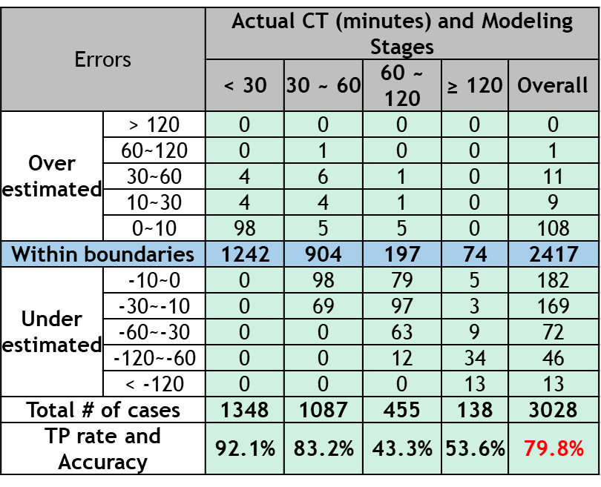
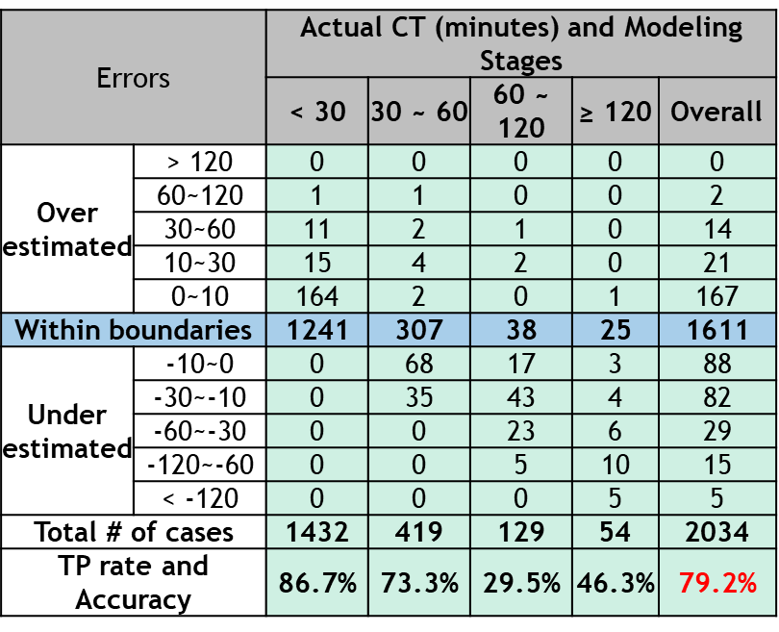
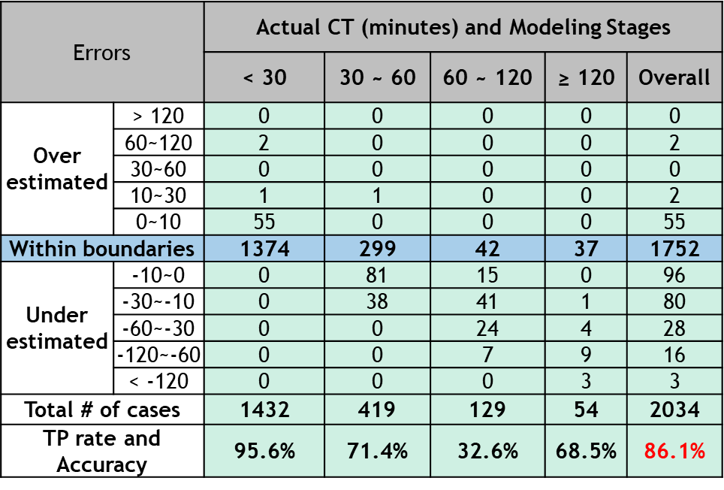
Distribution of estimation errors by CT categories (CPI & CPD)
I-495(2015-2017) ,I-95(2012-2017)
Data:I-95
Model: original
Data: I-495
Model: original
Data: I-495
Model: Updated (without supplemental
rules)
79.8%
79.2%
86.1%

Slide 20
Updates CF rules for I-495(2015-2017)
keep initial(I95) CF rules Modify the incident interval boundaries

Slide 21
Capability of modified CF rules
Only 13 CF cases in I-495 of the year 2015-2017
All cases can be captured by the initial(I-95) CF rules
12 cases within the upgraded interval boundaries (Accuracy is 92%)
Collision – Travel lane blockage cases - CF
[More than 3 TRAVEL lanes blocked] OR [More than 2 VEHICLES involved] OR [More than 1 TRUCKS involved] OR [More than 1 TOW services arrived]
YES
NO
[TRUCK involved]
[More than 1 VEHICLES involved]
YES
NO
YES
NO
Case: CF-4 Mean= 350 mins
180~270mins → 100%
Case: CF-3 Mean= 210 mins
150~250mins → 70%
150~270mins → 80%
150~420mins → 100%
Case: CF-2
Mean= 180 mins
150~210mins → 100%
Case: CF-1 Mean= 100mins
100~210mins → 50%
100%(2/2)
100%(7/7)
100%(2/2)
50%(1/2)
185 minutes
13.6 minutes

Slide 22
Developed supplemental rules of Updated Interval-based Model for I-495
(2015-2017 dataset)

Slide 23
Model update
Event ID: 28013355ca2604e30054fa2ec4235c0a
Collision with Property Damage (CPD)
1 travel lane blocked
NO vehicle involved
NO response units arrived
Weekday
Night
No Hazard material related
Actual CT= 101.8 mins
Estimated CT= 5~35 mins
Incomplete data

Slide 24
Model update
Event ID: c1ff8202ebc002c30058fa2ec4235c0a
Event open time: 3/11/2017 4:14:00 AM
Scene cleared time: 3/11/2017 6:29:00 AM
Collision with Personal Injury (CPI)
2 travel lane blocked
3 CAHRT arrived
8 Units response
Weekend, Night timePrince George
Dry pavement condition, No Hazard material related
Actual CT= 194.65mins
Estimated CT= 60~120 mins (-74.65 mins diff.)
Updated Estimated CT ≥ 120 mins
Supplemental rule
[PinceGeorge] & [More than 1 shoulder blocked] & [weekend] & [NON-PEAK] &[NIGHT] &[MORE THAN 3 LANES BLOCKED]&[FIREBOARD First Arrived]

Slide 25
Model update
Event ID: 1300ef049ca4070c0058fa2ec4235c0a
Event open time: 3/11/2017 4:14:00 AM
Scene cleared time: 3/11/2017 6:29:00 AM
Collision with Personal Injury (CPI)
4 travel lane blocked (2 shoulder)
FIREBOAD FIRST arrived
Weekend, Night time, No Holiday
Prince George
Dry pavement condition, No Hazard material related
Actual CT= 133.75mins
Estimated CT= 5~40 mins (-93.75 mins diff.)
Updated Estimated CT= 130~150 mins
Supplemental rule
[PinceGeorge] & [More than 1 shoulder blocked] & [weekend] & [NON-PEAK] &[NIGHT] &[MORE THAN 3 LANES BLOCKED]&[FIREBOARD First Arrived]

Slide 26
Event ID: 90000eabe5050816005afa2ec4235c0a
2f027864c56900590057fa2ec4235c0a
2 shoulder OR AUXILIARY LANE blocked
More than 3 units arrived (2+ CHART arrived)
Pickup involved
WEEKDAY, PEAK
Prince George
Dry pavement condition
Actual CT= 122.6mins & 132 mins
Estimated CT= 5~40 mins (-82.6 mins diff.)
CT= 5~35 mins (-97mins diff.)
Updated Estimated CT= 120~150 mins
Supplemental rule
[PinceGeorge] & [WEEKDAY]] & [MORE THAN 3 UNITS RESPONSE] & [More than 2 CHART arrived] &[More than 1 shoulder blocked OR AUXILIARY LANE blocked]

Slide 27
Model update
Event ID: 28004e86d09c06170056fa2ec4235c0a
Collision with Personal Injury (CPI)
4 travel lane blocked (2 shoulder)
HOLIDAY
Hazard material
[Truck Overturned]
Actual CT= 138.7mins
Estimated CT= 10~70 mins (-68.7 mins diff.)
Updated Estimated CT>120
Supplemental rule
[PinceGeorge] & [More than 1 shoulder blocked] & [weekend] & [NON-PEAK] &[NIGHT] &[MORE THAN 3 LANES BLOCKED]&[FIREBOARD First Arrived]

Slide 28
Model update
Event ID: 60000e36d6d103a70056fa2ec4235c0a
Collision with Property Damage (CPD)
2 travel lane blocked (AUXILIARY LANE blocked)
CHART FIRST arrived
2 SUV involved,1 Pickup involved
WEEKDAY
Truck Overturned
Actual CT= 100.48mins
Estimated CT= 5~35 mins (-65.48 mins diff.)
Updated Estimated CT ≥ 120 mins
Supplemental rule
[More than 2 SUV Involved] & [Pickup Involved] & [WEEKDAY]] & [CHART First arrived] & [[AUXILIARY LANE blocked]

Slide 29
Supplemental rules for I495 (2015-2017)
Collision – Travel lane blockage cases
 | Description |  | CT range (minutes) | Mean CT (minutes)
 | 2015-2017
 | [PINCEGEORGE] & [WEEKEND] & [MORE THAN 3 CHART ARRIVED] & [SOUTH] & [8+ RESPONSE UNITS ARRIVED] |  | ≥ 120mins(100%) | 219
 | [HAZARD MATERIAL] & [7+ RESPONSE UNITS ARRIVED] & [SOUTH] & [MORE THAN 2 CHART ARRIVED] & [TOW INVOLVED] |  | ≥ 150mins(80%) ≥ 80mins(100%) | 228
 | [PINCEGEORGE] & [12+ RESPONSE UNITS ARRIVED] & [TRUCK INVOLVED & TRUCK OVERTURNED] & [[AUXILIARY LANE BLOCKED] &[DAYTIME] |  | ≥ 120mins(100%) | 162
 | [PINCEGEORGE] & [MORE THAN 1 SHOULDER BLOCKED] & [WEEKEND] & [NON-PEAK] &[NIGHT] &[MORE THAN 3 LANES BLOCKED]&[FIREBOARD FIRST ARRIVED] |  | ≥ 120mins(100%) | 134
 | [PINCEGEORGE] & [WEEKDAY]] & [MORE THAN 3 UNITS RESPONSE] & [MORE THAN 2 CHART ARRIVED] &[MORE THAN 1 SHOULDER BLOCKED OR AUXILIARY LANE BLOCKED] |  | 120~150(100%) | 127
 | [MORE THAN 2 SUV INVOLVED] & [PICKUP INVOLVED] & [WEEKDAY]] & [CHART FIRST ARRIVED] & [[AUXILIARY LANE BLOCKED] |  | 90~120mins(100%) | 100

Slide 30
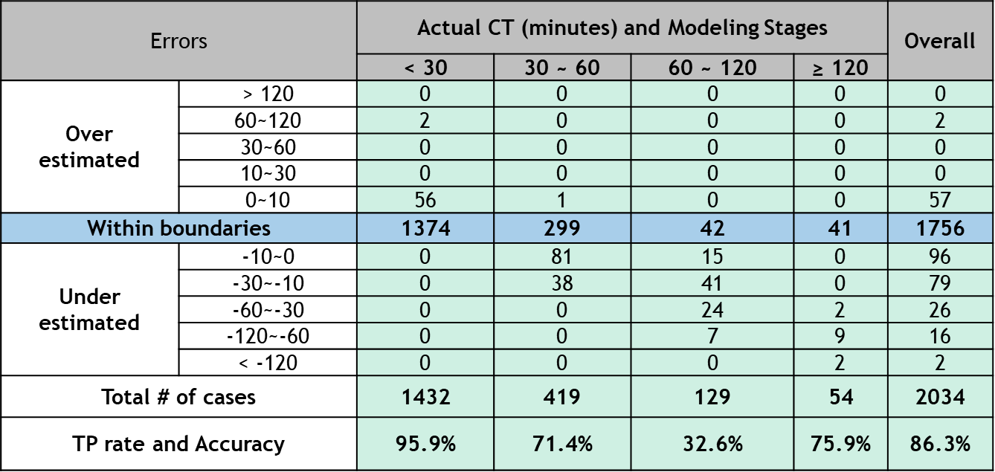
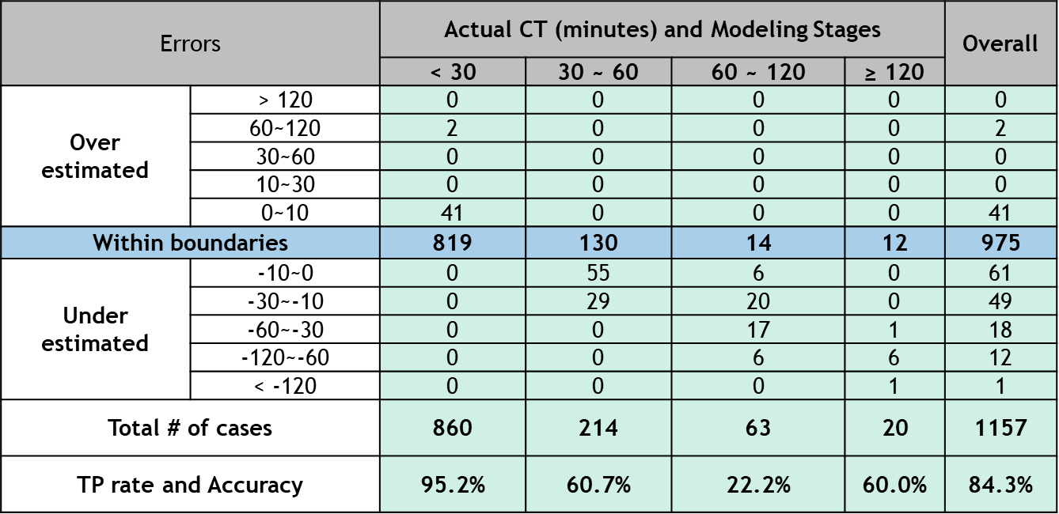
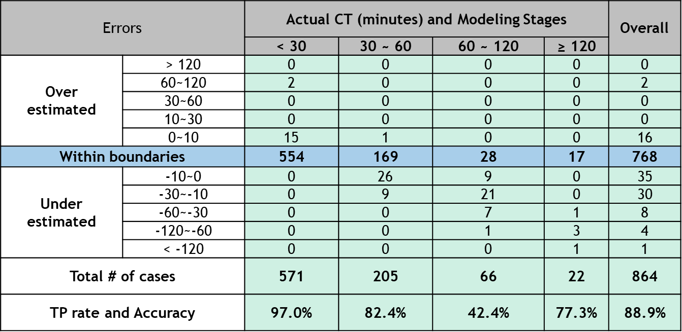
Distribution of estimation errors by CT categories
I495(2015-2017) after upgraded with supplemental rules and CF rules
CPI & CPD &CF
CPD
CPI

Slide 31
Evaluation results of Updated Interval-based Model for I-495
(2018 dataset)

Slide 32
Distribution of estimation errors by CT categories (CPI & CPD &CF)
I495 2018 dataset
Errors |  | Actual CT (minutes) and Modeling Stages |  |  |  | Overall
 |  | < 30 | 30 ~ 60 | 60 ~ 120 | ≥ 120
Over estimated | > 120 | 0 | 0 | 0 | 0 | 0
 | 60~120 | 0 | 1 | 0 | 0 | 1
 | 30~60 | 1 | 0 | 0 | 0 | 1
 | 10~30 | 3 | 0 | 0 | 0 | 3
 | 0~10 | 12 | 0 | 0 | 0 | 12
Within boundaries |  | 321 | 74 | 10 | 9 | 414
Under estimated | -10~0 | 0 | 18 | 11 | 1 | 30
 | -30~-10 | 0 | 9 | 10 | 0 | 19
 | -60~-30 | 0 | 0 | 17 | 1 | 18
 | -120~-60 | 0 | 0 | 2 | 3 | 5
 | < -120 | 0 | 0 | 0 | 1 | 1
Total # of cases |  | 337 | 102 | 50 | 15 | 504
TP rate and Accuracy |  | 95.3% | 72.5% | 20% | 60.0% | 82.1%
Need to update with adjusted and additional rules

Slide 33
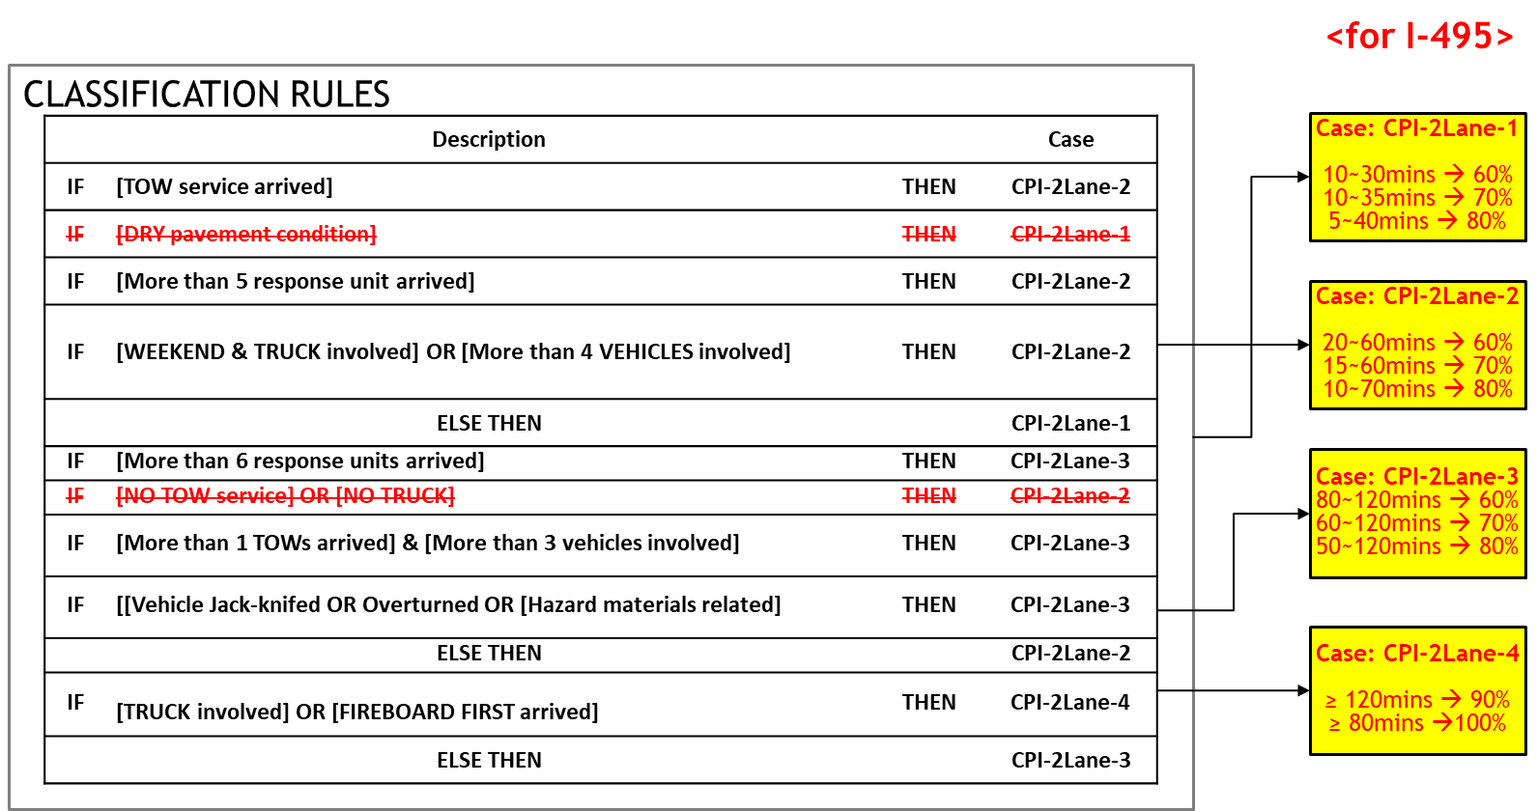
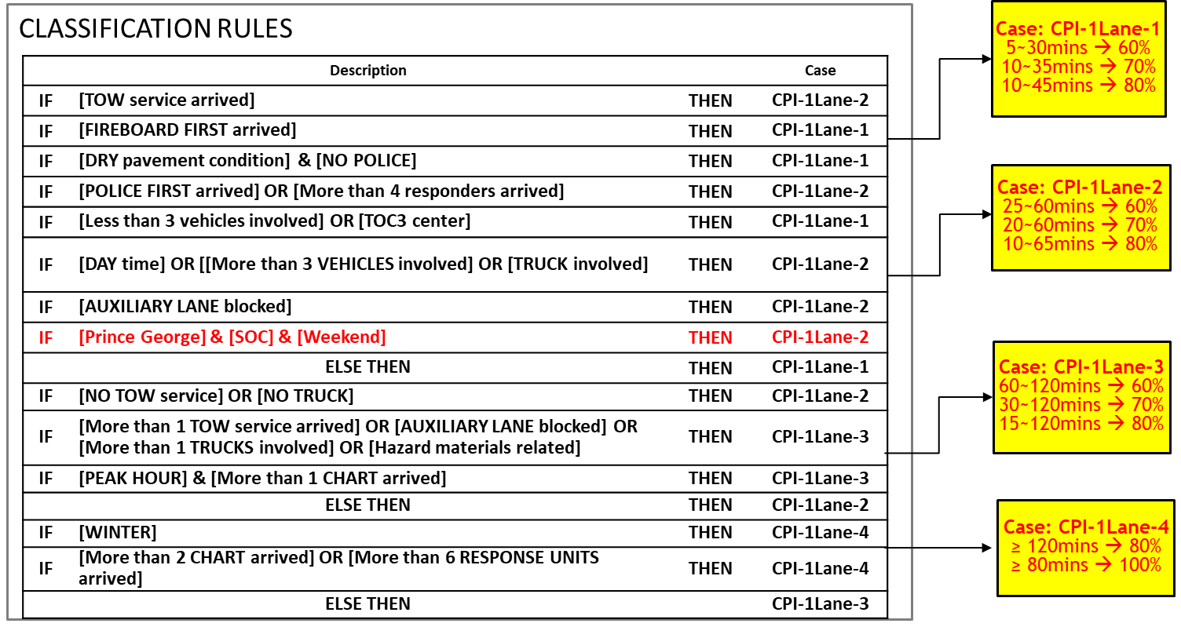
Model Update
CPI – 1 TL blockage cases
CPI – 2 TL blockage cases

Slide 34
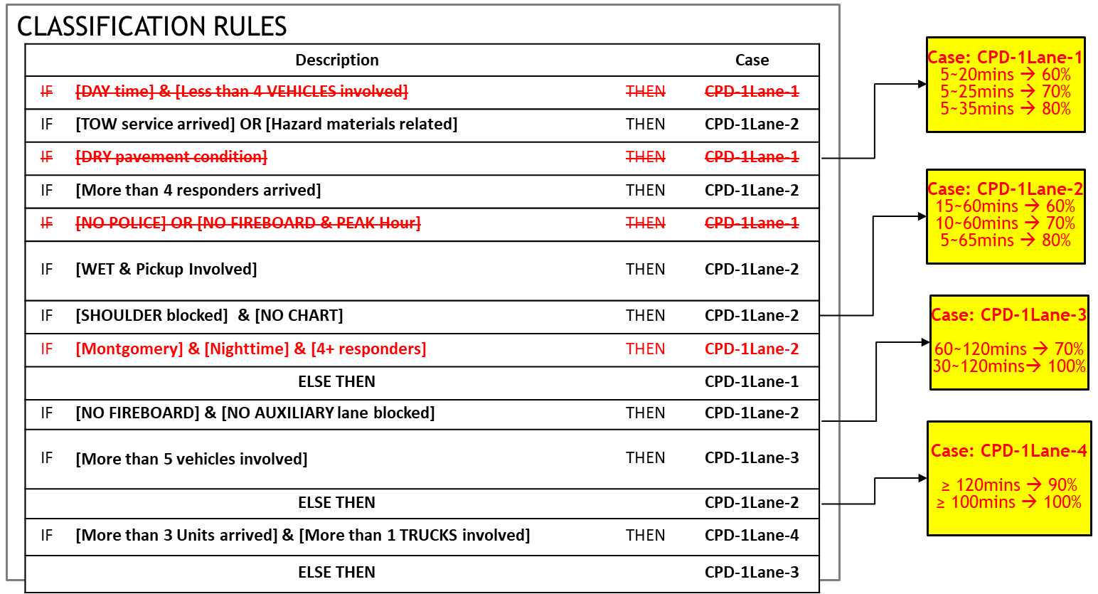
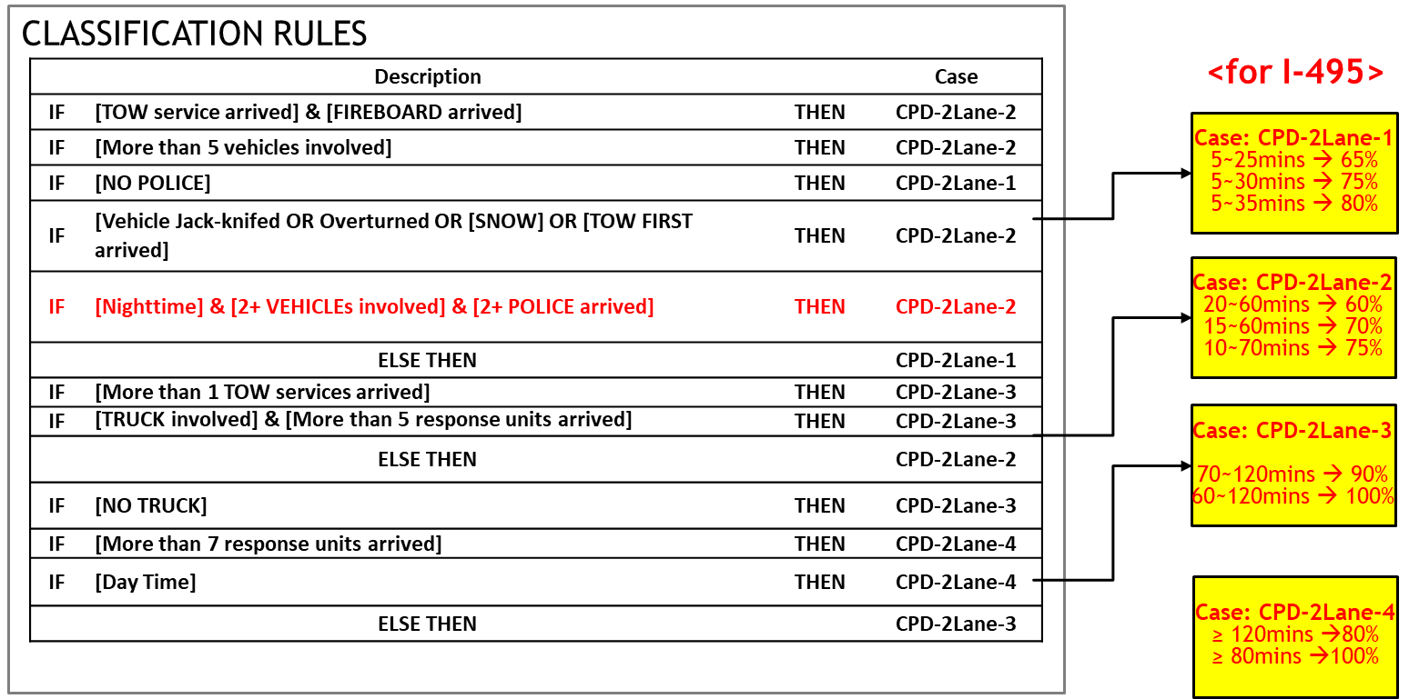
Model Update
CPD – 1 TL blockage cases
CPD – 2 TL blockage cases

Slide 35
Model Update
Event ID: 21ffafa391ca01ca005bd32ec4235c0a
CF
Medical arrived
NIGHT
WET
Actual CT= 480.05mins
Estimated CT= 150~210 mins (-270.05 mins diff.)
Updated Estimated CT ≥ 150~480
Supplemental rule
[More than 2 SUV Involved] & [Pickup Involved] & [WEEKDAY]] & [CHART First arrived] & [[AUXILIARY LANE blocked]

Slide 36
Model Update
Event ID: 1200effbff9a00e6005bd32ec4235c0a
Collision with Property Damage (CPD)
2 travel lane blocked (AUXILIARY LANE blocked)
2 TOW arrived
Pickup involved
HOLIDAY
Actual CT= 193.28mins
Estimated CT= 70~120 mins (-73.28mins diff.)
Updated Estimated CT ≥ 180
Supplemental rule
[2 AUXILIARY LANE blocked] & [2 TOW arrived] & [Pickup involved] & [HOLIDAY]

Slide 37
Model Update
Event ID: e4001329dca3027e005bd32ec4235c0a
Collision with Personal Injury (CPI)
4 travel lane blocked (2 shoulder)
13 units responded
2 Trucks involved
PEAK
Actual CT= 253.21mins
Estimated CT= 60~120 mins (-133.21 mins diff.)
Updated Estimated CT ≥ 210~320
Supplemental rule
[4 travel lane blocked ] & [2 Trucks Involved] & [PEAK]] & [13 units arrived] & [[2 shoulder blocked]

Slide 38
Distribution of estimation errors by CT categories
Before model updates (all types of collisions)
After model updates (all types of collisions)
Errors (2015-2017) |  | Actual CT (minutes) |  |  |  | Over all
 |  | < 30 | 30 ~ 60 | 60 ~ 120 | ≥ 120
Over estimated | > 120 | 0 | 0 | 0 | 0 | 0
 | 60~120 | 2 | 0 | 0 | 0 | 2
 | 30~60 | 0 | 0 | 0 | 0 | 0
 | 10~30 | 0 | 0 | 0 | 0 | 0
 | 0~10 | 56 | 1 | 0 | 0 | 57
Within boundaries |  | 1374 | 299 | 42 | 41 | 1756
Under estimated | -10~0 | 0 | 81 | 15 | 0 | 96
 | -30~-10 | 0 | 38 | 41 | 0 | 79
 | -60~-30 | 0 | 0 | 24 | 2 | 26
 | -120~-60 | 0 | 0 | 7 | 9 | 16
 | < -120 | 0 | 0 | 0 | 2 | 2
Total # of cases |  | 1432 | 419 | 129 | 54 | 2034
TP rate and Accuracy |  | 95.9% | 71.4% | 32.6% | 75.9% | 86.3%
Errors (2015-2017) |  | Actual CT (minutes) |  |  |  | Over all
 |  | < 30 | 30 ~ 60 | 60 ~ 120 | ≥ 120
Over estimated | > 120 | 0 | 0 | 0 | 0 | 0
 | 60~120 | 2 | 0 | 0 | 0 | 2
 | 30~60 | 2 | 0 | 0 | 0 | 2
 | 10~30 | 0 | 0 | 0 | 0 | 0
 | 0~10 | 56 | 1 | 0 | 0 | 57
Within boundaries |  | 1372 | 326 | 50 | 41 | 1789
Under estimated | -10~0 | 0 | 64 | 17 | 0 | 81
 | -30~-10 | 0 | 28 | 37 | 0 | 65
 | -60~-30 | 0 | 0 | 20 | 1 | 21
 | -120~-60 | 0 | 0 | 5 | 10 | 15
 | < -120 | 0 | 0 | 0 | 2 | 2
Total # of cases |  | 1432 | 419 | 129 | 54 | 2034
TP rate and Accuracy |  | 95.8% | 77.8% | 38.8% | 75.9% | 88.0%
Errors (2018) |  | Actual CT (minutes) |  |  |  | Over all
 |  | < 30 | 30 ~ 60 | 60 ~ 120 | ≥ 120
Over estimated | > 120 | 0 | 0 | 0 | 0 | 0
 | 60~120 | 0 | 1 | 0 | 0 | 1
 | 30~60 | 1 | 0 | 0 | 0 | 1
 | 10~30 | 3 | 0 | 0 | 0 | 3
 | 0~10 | 12 | 0 | 0 | 0 | 12
Within boundaries |  | 321 | 74 | 10 | 9 | 414
Under estimated | -10~0 | 0 | 18 | 11 | 1 | 30
 | -30~-10 | 0 | 9 | 10 | 0 | 19
 | -60~-30 | 0 | 0 | 17 | 1 | 18
 | -120~-60 | 0 | 0 | 2 | 3 | 5
 | < -120 | 0 | 0 | 0 | 1 | 1
Total # of cases |  | 337 | 102 | 50 | 15 | 504
TP rate and Accuracy |  | 95.3% | 72.5% | 20.0% | 60.0% | 82.1%
Errors (2018) |  | Actual CT (minutes) |  |  |  | Over all
 |  | < 30 | 30 ~ 60 | 60 ~ 120 | ≥ 120
Over estimated | > 120 | 0 | 0 | 0 | 0 | 0
 | 60~120 | 0 | 1 | 0 | 0 | 1
 | 30~60 | 1 | 0 | 0 | 0 | 1
 | 10~30 | 3 | 0 | 0 | 0 | 3
 | 0~10 | 12 | 0 | 1 | 0 | 13
Within boundaries |  | 321 | 79 | 22 | 11 | 433
Under estimated | -10~0 | 0 | 14 | 9 | 1 | 24
 | -30~-10 | 0 | 8 | 6 | 0 | 14
 | -60~-30 | 0 | 0 | 10 | 0 | 10
 | -120~-60 | 0 | 0 | 2 | 2 | 4
 | < -120 | 0 | 0 | 0 | 1 | 1
Total # of cases |  | 337 | 102 | 50 | 15 | 504
TP rate and Accuracy |  | 95.3% | 77.5% | 44.0% | 73.3% | 85.9%

Slide 39
Appendix

Slide 40
Distribution of estimation errors by CT categories
After model updates (CPD - 1)
After model updates (CPD - 2)
Errors (2015-2017) |  | Actual CT (minutes) |  |  |  | Over all
 |  | < 30 | 30 ~ 60 | 60 ~ 120 | ≥ 120
Over estimated | > 120 | 0 | 0 | 0 | 0 | 0
 | 60~120 | 0 | 0 | 0 | 0 | 0
 | 30~60 | 0 | 0 | 0 | 0 | 0
 | 10~30 | 0 | 0 | 0 | 0 | 0
 | 0~10 | 30 | 0 | 0 | 0 | 30
Within boundaries |  | 565 | 98 | 8 | 4 | 675
Under estimated | -10~0 | 0 | 25 | 5 | 0 | 30
 | -30~-10 | 0 | 14 | 12 | 0 | 26
 | -60~-30 | 0 | 0 | 6 | 1 | 7
 | -120~-60 | 0 | 0 | 2 | 5 | 7
 | < -120 | 0 | 0 | 0 | 1 | 1
Total # of cases |  | 595 | 137 | 33 | 11 | 776
TP rate and Accuracy |  | 95.0% | 71.5% | 24.2% | 36.4% | 87.0%
Errors (2015-2017) |  | Actual CT (minutes) |  |  |  | Over all
 |  | < 30 | 30 ~ 60 | 60 ~ 120 | ≥ 120
Over estimated | > 120 | 0 | 0 | 0 | 0 | 0
 | 60~120 | 0 | 0 | 0 | 0 | 0
 | 30~60 | 0 | 0 | 0 | 0 | 0
 | 10~30 | 0 | 0 | 0 | 0 | 0
 | 0~10 | 8 | 0 | 0 | 0 | 8
Within boundaries |  | 201 | 34 | 7 | 5 | 247
Under estimated | -10~0 | 0 | 14 | 2 | 0 | 16
 | -30~-10 | 0 | 4 | 6 | 0 | 10
 | -60~-30 | 0 | 0 | 4 | 0 | 4
 | -120~-60 | 0 | 0 | 3 | 1 | 4
 | < -120 | 0 | 0 | 0 | 0 | 0
Total # of cases |  | 209 | 52 | 22 | 6 | 289
TP rate and Accuracy |  | 96.2% | 65.4% | 31.8% | 83.3% | 85.5%
Errors (2018) |  | Actual CT (minutes) |  |  |  | Over all
 |  | < 30 | 30 ~ 60 | 60 ~ 120 | ≥ 120
Over estimated | > 120 | 0 | 0 | 0 | 0 | 0
 | 60~120 | 0 | 0 | 0 | 0 | 0
 | 30~60 | 0 | 0 | 0 | 0 | 0
 | 10~30 | 1 | 0 | 0 | 0 | 1
 | 0~10 | 5 | 0 | 0 | 0 | 5
Within boundaries |  | 159 | 18 | 4 | 0 | 181
Under estimated | -10~0 | 0 | 7 | 4 | 0 | 11
 | -30~-10 | 0 | 3 | 2 | 0 | 5
 | -60~-30 | 0 | 0 | 4 | 0 | 4
 | -120~-60 | 0 | 0 | 2 | 1 | 3
 | < -120 | 0 | 0 | 0 | 0 | 0
Total # of cases |  | 165 | 28 | 16 | 1 | 210
TP rate and Accuracy |  | 96.4% | 64.3% | 25.0% | 0.0% | 86.2%
Errors (2018) |  | Actual CT (minutes) |  |  |  | Over all
 |  | < 30 | 30 ~ 60 | 60 ~ 120 | ≥ 120
Over estimated | > 120 | 0 | 0 | 0 | 0 | 0
 | 60~120 | 0 | 0 | 0 | 0 | 0
 | 30~60 | 0 | 0 | 0 | 0 | 0
 | 10~30 | 0 | 0 | 0 | 0 | 0
 | 0~10 | 2 | 0 | 0 | 0 | 2
Within boundaries |  | 51 | 9 | 1 | 3 | 64
Under estimated | -10~0 | 0 | 6 | 1 | 1 | 8
 | -30~-10 | 0 | 2 | 2 | 0 | 4
 | -60~-30 | 0 | 0 | 2 | 0 | 2
 | -120~-60 | 0 | 0 | 0 | 0 | 0
 | < -120 | 0 | 0 | 0 | 0 | 0
Total # of cases |  | 53 | 17 | 6 | 4 | 80
TP rate and Accuracy |  | 96.2% | 52.9% | 16.7% | 75.0% | 80.0%

Slide 41
Distribution of estimation errors by CT categories
After model updates (CPD – 3+)
After model updates (CPI - 1)
Errors (2015-2017) |  | Actual CT (minutes) |  |  |  | Over all
 |  | < 30 | 30 ~ 60 | 60 ~ 120 | ≥ 120
Over estimated | > 120 | 0 | 0 | 0 | 0 | 0
 | 60~120 | 0 | 0 | 0 | 0 | 0
 | 30~60 | 0 | 0 | 0 | 0 | 0
 | 10~30 | 0 | 0 | 0 | 0 | 0
 | 0~10 | 3 | 0 | 0 | 0 | 3
Within boundaries |  | 53 | 17 | 3 | 3 | 76
Under estimated | -10~0 | 0 | 3 | 1 | 0 | 4
 | -30~-10 | 0 | 5 | 0 | 0 | 5
 | -60~-30 | 0 | 0 | 4 | 0 | 4
 | -120~-60 | 0 | 0 | 0 | 0 | 0
 | < -120 | 0 | 0 | 0 | 0 | 0
Total # of cases |  | 56 | 25 | 8 | 3 | 92
TP rate and Accuracy |  | 94.6% | 68.0% | 37.5% | 100.0% | 82.6%
Errors (2015-2017) |  | Actual CT (minutes) |  |  |  | Over all
 |  | < 30 | 30 ~ 60 | 60 ~ 120 | ≥ 120
Over estimated | > 120 | 0 | 0 | 0 | 0 | 0
 | 60~120 | 0 | 0 | 0 | 0 | 0
 | 30~60 | 0 | 0 | 0 | 0 | 0
 | 10~30 | 0 | 0 | 0 | 0 | 0
 | 0~10 | 5 | 0 | 0 | 0 | 5
Within boundaries |  | 281 | 79 | 8 | 6 | 374
Under estimated | -10~0 | 0 | 9 | 6 | 0 | 15
 | -30~-10 | 0 | 2 | 10 | 0 | 12
 | -60~-30 | 0 | 0 | 5 | 0 | 5
 | -120~-60 | 0 | 0 | 0 | 1 | 1
 | < -120 | 0 | 0 | 0 | 1 | 1
Total # of cases |  | 286 | 90 | 29 | 8 | 413
TP rate and Accuracy |  | 98.3% | 87.8% | 27.6% | 75.0% | 90.6%
Errors (2018) |  | Actual CT (minutes) |  |  |  | Over all
 |  | < 30 | 30 ~ 60 | 60 ~ 120 | ≥ 120
Over estimated | > 120 | 0 | 0 | 0 | 0 | 0
 | 60~120 | 0 | 0 | 0 | 0 | 0
 | 30~60 | 1 | 0 | 0 | 0 | 1
 | 10~30 | 2 | 0 | 0 | 0 | 2
 | 0~10 | 1 | 0 | 0 | 0 | 1
Within boundaries |  | 14 | 5 | 1 | 2 | 22
Under estimated | -10~0 | 0 | 0 | 0 | 0 | 0
 | -30~-10 | 0 | 0 | 0 | 0 | 0
 | -60~-30 | 0 | 0 | 0 | 0 | 0
 | -120~-60 | 0 | 0 | 0 | 1 | 1
 | < -120 | 0 | 0 | 0 | 1 | 1
Total # of cases |  | 18 | 5 | 1 | 4 | 28
TP rate and Accuracy |  | 77.8% | 100.0% | 100.0% | 50.0% | 78.6%
Errors (2018) |  | Actual CT (minutes) |  |  |  | Over all
 |  | < 30 | 30 ~ 60 | 60 ~ 120 | ≥ 120
Over estimated | > 120 | 0 | 0 | 0 | 0 | 0
 | 60~120 | 0 | 0 | 0 | 0 | 0
 | 30~60 | 0 | 0 | 0 | 0 | 0
 | 10~30 | 0 | 0 | 0 | 0 | 0
 | 0~10 | 3 | 0 | 0 | 0 | 3
Within boundaries |  | 52 | 19 | 5 | 0 | 76
Under estimated | -10~0 | 0 | 0 | 1 | 0 | 1
 | -30~-10 | 0 | 0 | 2 | 0 | 2
 | -60~-30 | 0 | 0 | 3 | 0 | 3
 | -120~-60 | 0 | 0 | 0 | 0 | 0
 | < -120 | 0 | 0 | 0 | 0 | 0
Total # of cases |  | 55 | 19 | 11 | 0 | 85
TP rate and Accuracy |  | 94.5% | 100.0% | 45.5% | - | 89.4%

Slide 42
Distribution of estimation errors by CT categories
After model updates (CPI - 2)
After model updates (CPI – 3+)
Errors (2015-2017) |  | Actual CT (minutes) |  |  |  | Over all
 |  | < 30 | 30 ~ 60 | 60 ~ 120 | ≥ 120
Over estimated | > 120 | 0 | 0 | 0 | 0 | 0
 | 60~120 | 0 | 0 | 0 | 0 | 0
 | 30~60 | 2 | 0 | 0 | 0 | 2
 | 10~30 | 0 | 0 | 0 | 0 | 0
 | 0~10 | 6 | 1 | 0 | 0 | 7
Within boundaries |  | 214 | 54 | 14 | 3 | 285
Under estimated | -10~0 | 0 | 11 | 3 | 0 | 14
 | -30~-10 | 0 | 3 | 6 | 0 | 9
 | -60~-30 | 0 | 0 | 0 | 0 | 0
 | -120~-60 | 0 | 0 | 0 | 1 | 1
 | < -120 | 0 | 0 | 0 | 0 | 0
Total # of cases |  | 222 | 69 | 23 | 4 | 318
TP rate and Accuracy |  | 96.4% | 78.3% | 60.9% | 75.0% | 89.6%
Errors (2015-2017) |  | Actual CT (minutes) |  |  |  | Over all
 |  | < 30 | 30 ~ 60 | 60 ~ 120 | ≥ 120
Over estimated | > 120 | 0 | 0 | 0 | 0 | 0
 | 60~120 | 2 | 0 | 0 | 0 | 2
 | 30~60 | 0 | 0 | 0 | 0 | 0
 | 10~30 | 0 | 0 | 0 | 0 | 0
 | 0~10 | 4 | 0 | 0 | 0 | 4
Within boundaries |  | 57 | 44 | 10 | 8 | 119
Under estimated | -10~0 | 0 | 2 | 0 | 0 | 2
 | -30~-10 | 0 | 0 | 3 | 0 | 3
 | -60~-30 | 0 | 0 | 1 | 0 | 1
 | -120~-60 | 0 | 0 | 0 | 2 | 2
 | < -120 | 0 | 0 | 0 | 0 | 0
Total # of cases |  | 63 | 46 | 14 | 10 | 133
TP rate and Accuracy |  | 90.5% | 95.7% | 71.4% | 80.0% | 89.5%
Errors (2018) |  | Actual CT (minutes) |  |  |  | Over all
 |  | < 30 | 30 ~ 60 | 60 ~ 120 | ≥ 120
Over estimated | > 120 | 0 | 0 | 0 | 0 | 0
 | 60~120 | 0 | 0 | 0 | 0 | 0
 | 30~60 | 0 | 0 | 0 | 0 | 0
 | 10~30 | 0 | 0 | 0 | 0 | 0
 | 0~10 | 0 | 0 | 1 | 0 | 1
Within boundaries |  | 29 | 16 | 4 | 1 | 50
Under estimated | -10~0 | 0 | 1 | 1 | 0 | 2
 | -30~-10 | 0 | 3 | 0 | 0 | 3
 | -60~-30 | 0 | 0 | 1 | 0 | 1
 | -120~-60 | 0 | 0 | 0 | 0 | 0
 | < -120 | 0 | 0 | 0 | 0 | 0
Total # of cases |  | 29 | 20 | 7 | 1 | 57
TP rate and Accuracy |  | 100.0% | 80.0% | 57.1% | 100.0% | 87.7%
Errors (2018) |  | Actual CT (minutes) |  |  |  | Over all
 |  | < 30 | 30 ~ 60 | 60 ~ 120 | ≥ 120
Over estimated | > 120 | 0 | 0 | 0 | 0 | 0
 | 60~120 | 0 | 1 | 0 | 0 | 1
 | 30~60 | 0 | 0 | 0 | 0 | 0
 | 10~30 | 0 | 0 | 0 | 0 | 0
 | 0~10 | 1 | 0 | 0 | 0 | 1
Within boundaries |  | 16 | 12 | 7 | 3 | 38
Under estimated | -10~0 | 0 | 0 | 2 | 0 | 2
 | -30~-10 | 0 | 0 | 0 | 0 | 0
 | -60~-30 | 0 | 0 | 0 | 0 | 0
 | -120~-60 | 0 | 0 | 0 | 0 | 0
 | < -120 | 0 | 0 | 0 | 0 | 0
Total # of cases |  | 17 | 13 | 9 | 3 | 42
TP rate and Accuracy |  | 94.1% | 92.3% | 77.8% | 100.0% | 90.5%

Slide 43
Distribution of estimation errors by CT categories
After model updates (CF)
Errors (2015-2017) |  | Actual CT (minutes) |  |  |  | Over all
 |  | < 30 | 30 ~ 60 | 60 ~ 120 | ≥ 120
Over estimated | > 120 | 0 | 0 | 0 | 0 | 0
 | 60~120 | 0 | 0 | 0 | 0 | 0
 | 30~60 | 0 | 0 | 0 | 0 | 0
 | 10~30 | 0 | 0 | 0 | 0 | 0
 | 0~10 | 0 | 0 | 0 | 0 | 0
Within boundaries |  | 1 | 0 | 0 | 12 | 13
Under estimated | -10~0 | 0 | 0 | 0 | 0 | 0
 | -30~-10 | 0 | 0 | 0 | 0 | 0
 | -60~-30 | 0 | 0 | 0 | 0 | 0
 | -120~-60 | 0 | 0 | 0 | 0 | 0
 | < -120 | 0 | 0 | 0 | 0 | 0
Total # of cases |  | 1 | 0 | 0 | 12 | 13
TP rate and Accuracy |  | 100.0% | - | - | 100.0% | 100.0%
Errors (2018) |  | Actual CT (minutes) |  |  |  | Over all
 |  | < 30 | 30 ~ 60 | 60 ~ 120 | ≥ 120
Over estimated | > 120 | 0 | 0 | 0 | 0 | 0
 | 60~120 | 0 | 0 | 0 | 0 | 0
 | 30~60 | 0 | 0 | 0 | 0 | 0
 | 10~30 | 0 | 0 | 0 | 0 | 0
 | 0~10 | 0 | 0 | 0 | 0 | 0
Within boundaries |  | 0 | 0 | 0 | 2 | 2
Under estimated | -10~0 | 0 | 0 | 0 | 0 | 0
 | -30~-10 | 0 | 0 | 0 | 0 | 0
 | -60~-30 | 0 | 0 | 0 | 0 | 0
 | -120~-60 | 0 | 0 | 0 | 0 | 0
 | < -120 | 0 | 0 | 0 | 0 | 0
Total # of cases |  | 0 | 0 | 0 | 2 | 2
TP rate and Accuracy |  | - | - | - | 100.0% | 100.0%

